Slide 1

Note: The data and information in this document is reflective of a hypothetical situation and client. This document is to be used for KPMG Virtual Internship purposes only.
Sprocket Central Pty Ltd
Data analytics approach
[Division Name] - [Engagement Manager], [Senior Consultant], [Junior Consultant]

Slide 2
Note: The data and information in this document is reflective of a hypothetical situation and client. This document is to be used for KPMG Virtual Internship purposes only.
Agenda
Introduction
Data Exploration
Model Development
Interpretation

Slide 3
Note: The data and information in this document is reflective of a hypothetical situation and client. This document is to be used for KPMG Virtual Internship purposes only.
Introduction
Problem Statement
Customer Analysis
Sprocket central pty ltd is a company that specializes in high quality bike and accessories
The company is targeting 1000 new customers
The company is focused in maximizing profit through bike sales
Age Distribution
Number of Bike purchase in 3 years
Job industry
Wealth segments
Number of cars own on each states
customer profile

Slide 4
Note: The data and information in this document is reflective of a hypothetical situation and client. This document is to be used for KPMG Virtual Internship purposes only.
Data Exploration
Data Quality Assessment
Data Quality Issues identified in transaction, Customer demographic and customer address datasets
Dataset | Accuracy | Completeness | Relevancy | validity | Consistency
Customer Demographic | Age: Missing DOB: In-accurate | Job Title: Blanks | Default column: Irrelevant |  | Gender: Inconsistent
Transaction | Profit: Missing | Online orders: Blanks Brands: Blanks | Cancelled status Filtered out | List price and product sold: format
Customer Address |  |  |  |  | States: Inconsistent

Slide 5
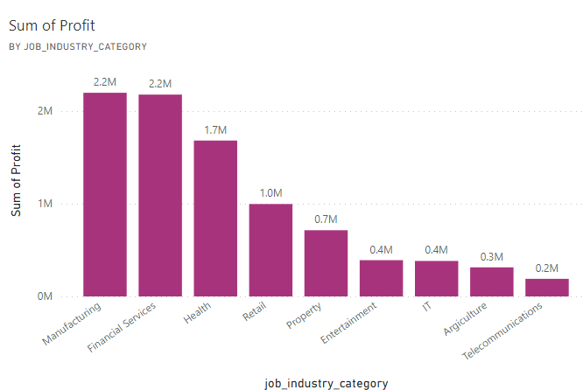
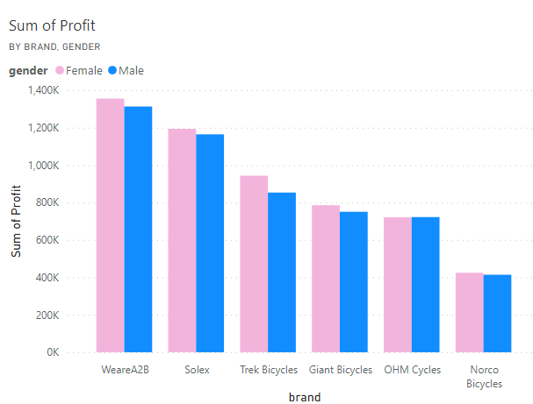
Note: The data and information in this document is reflective of a hypothetical situation and client. This document is to be used for KPMG Virtual Internship purposes only.
Model Development
Manufacturing, financial service and health, retail have the highest profit in job industry category
Most of product purchase by Female and highest profit from WeareA2B, Solex, Trek Bicycles

Slide 6
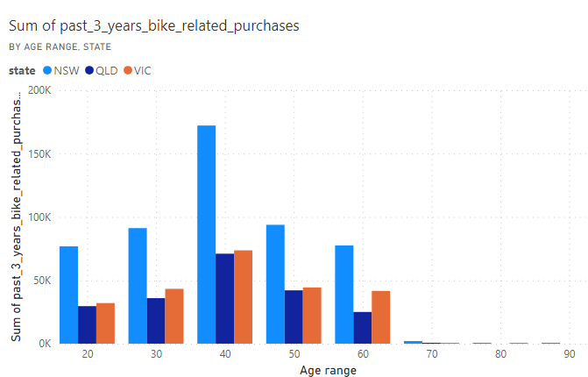
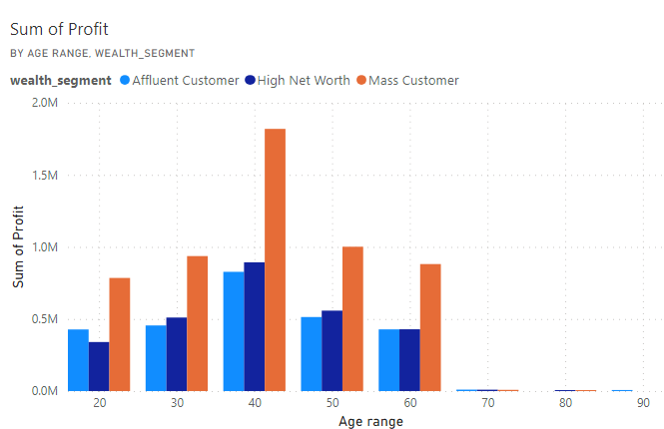
Note: The data and information in this document is reflective of a hypothetical situation and client. This document is to be used for KPMG Virtual Internship purposes only.
Model Development
Most of the middle age person from 35 to 45 are the promising customer from New south wales and victoria states
Mass customer have the highest profit followed by hugh net worth and finally affluent customer

Slide 7
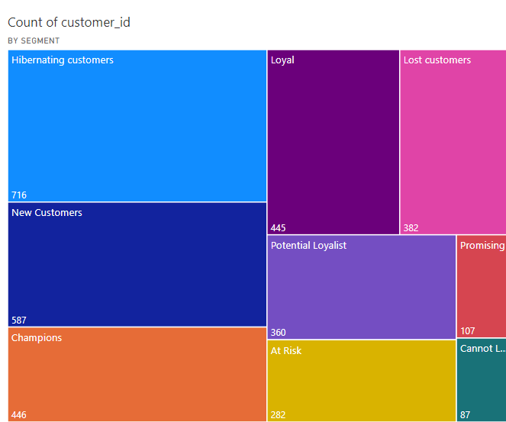
Note: The data and information in this document is reflective of a hypothetical situation and client. This document is to be used for KPMG Virtual Internship purposes only.
Model Development
Based on the frequency, recency and the monetary of the purchase made a customer profile.
Most of the customer are the hibernating
New customers are in the second position and followed by champion customers and loyal are in the forth.

Slide 8
Note: The data and information in this document is reflective of a hypothetical situation and client. This document is to be used for KPMG Virtual Internship purposes only.
Model Development
Customer Classification : Targeting the high value customer
Middle age 35 to 45 are the targeting customer
Manufacturing, financial service and health industry
Majority of the customers are female
customers are mostly live in New south wales and victoria states
Most of the customers are from the mass wealth segment

Slide 9
Note: The data and information in this document is reflective of a hypothetical situation and client. This document is to be used for KPMG Virtual Internship purposes only.
Interpretation
One of the most customer to the company
Customer ID | Age | Gender | Area | Industry | Wealth segment
339 | 39 | Female | NSW | Health | Mass
528 | 44 | Female | NSW | Manufacturing | Mass
367 | 38 | Female | NSW | Manufacturing | Health
2572 | 37 | Female | NSW | Health | Mass
3195 | 42 | Female | NSW | Manufacturing | Mass

Slide 10
Note: The data and information in this document is reflective of a hypothetical situation and client. This document is to be used for KPMG Virtual Internship purposes only.
Thank you

